Slide 1
Object Oriented Programming using C#
Unit III

Slide 2
OOP Principles
Encapsulation
Inheritance
Polymorphism

Slide 3
What is an Object?
An object of a class is a logical representation of a real world object in memory of computer.
An object in real world is defined by its characteristics and in computer it is represented by its members and functions.

Slide 4
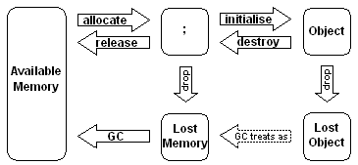
Lifecycle of an Object

Slide 5
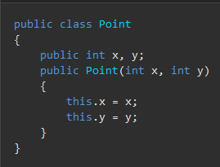
Building Classes
A class declaration starts with a header that specifies the attributes and modifiers of the class, the name of the class, the base class (if given), and the interfaces implemented by the class.
The header is followed by the class body, which consists of a list of member declarations written between the delimiters { and }.

Slide 6
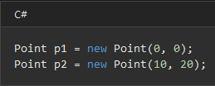
Instance of Classes
Instances of classes are created using the new operator, which allocates memory for a new instance, invokes a constructor to initialize the instance, and returns a reference to the instance.
The following statements create two Point objects and store references to those objects in two variables:

Slide 7
Defining Properties
A property is a member that provides a flexible mechanism to read, write, or compute the value of a private field.
Properties can be used as if they are public data members, but they are actually special methods called accessors.
This enables data to be accessed easily and still helps promote the safety and flexibility of methods.
Properties enable a class to expose a public way of getting and setting values, while hiding implementation or verification code.

Slide 8
Defining Properties
A get property accessor is used to return the property value, and a set property accessor is used to assign a new value.
The value keyword is used to define the value being assigned by the set accessor.
Properties can be read-write (they have both a get and a set accessor), read-only (they have a get accessor but no set accessor), or write-only (they have a set accessor, but no get accessor).
Write-only properties are rare and are most commonly used to restrict access to sensitive data.

Slide 9
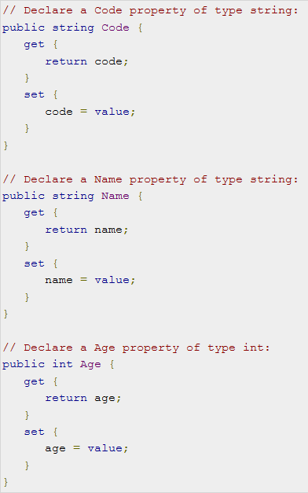
Defining Properties
Example

Slide 10
Auto-Implemented Property
In C# 3.0 and later, auto-implemented properties make property-declaration more concise when no additional logic is required in the property accessors.
They also enable client code to create objects. When you declare a property as shown in the following example, the compiler creates a private, anonymous backing field that can only be accessed through the property's get and set accessors.

Slide 11
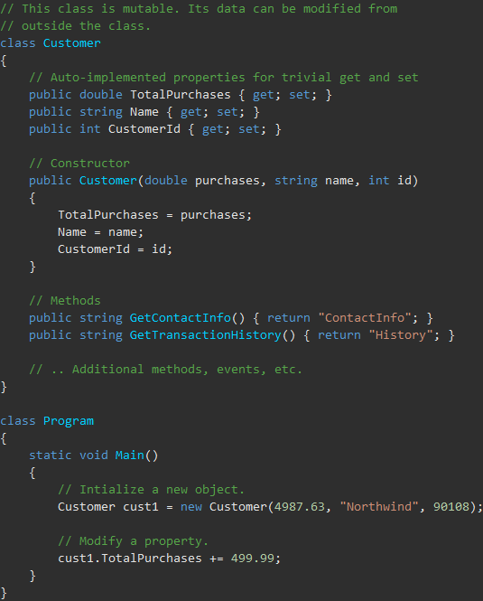

Slide 12
Defining Methods
A method is a code block that contains a series of statements.
A program causes the statements to be executed by calling the method and specifying any required method arguments.
In C#, every executed instruction is performed in the context of a method.
The Main method is the entry point for every C# application and it's called by the common language runtime (CLR) when the program is started.

Slide 13
Defining Methods
Methods are declared in a class, struct, or interface by specifying the access level such as public or private, optional modifiers such as abstract or sealed, the return value, the name of the method, and any method parameters.
These parts together are the signature of the method.
Method parameters are enclosed in parentheses and are separated by commas.
Empty parentheses indicate that the method requires no parameters.
This class contains four methods:

Slide 14
Defining Methods
abstract class Motorcycle
{
// Anyone can call this.
public void StartEngine() {/* Method statements here */ }
// Only derived classes can call this.
protected void AddGas(int gallons) { /* Method statements here */ }
// Derived classes can override the base class implementation.
public virtual int Drive(int miles, int speed) { /* Method statements here */ return 1; }
// Derived classes must implement this.
public abstract double GetTopSpeed();
}

Slide 15
Defining Methods
Calling a method on an object is like accessing a field.
After the object name, add a period, the name of the method, and parentheses.
Arguments are listed within the parentheses, and are separated by commas.
The methods of the Motorcycle class can therefore be called as in the following example:

Slide 16
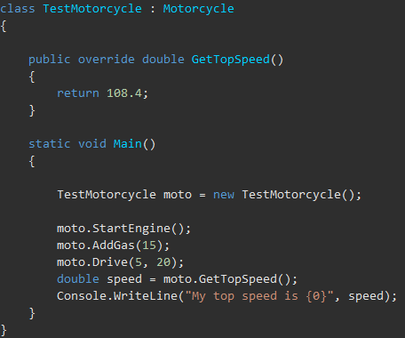
Defining Methods

Slide 17
Defining Methods
Method parameters vs. arguments
The method definition specifies the names and types of any parameters that are required.
When calling code calls the method, it provides concrete values called arguments for each parameter.
The arguments must be compatible with the parameter type but the argument name (if any) used in the calling code doesn't have to be the same as the parameter named defined in the method. For example:

Slide 18
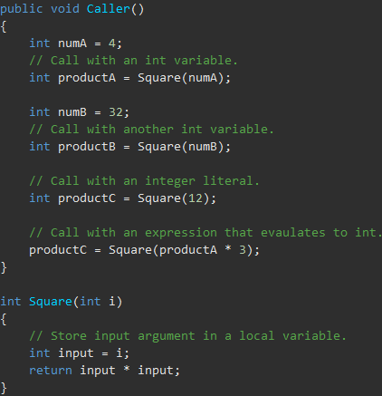
Argument
Parameter

Slide 19
Defining Methods
Passing by reference vs. passing by value
By default, when an instance of a value type is passed to a method, its copy is passed instead of the instance itself.
Therefore, changes to the argument have no effect on the original instance in the calling method.
To pass a value-type instance by reference, use the ref keyword.
When an object of a reference type is passed to a method, a reference to the object is passed.
That is, the method receives not the object itself but an argument that indicates the location of the object.
If you change a member of the object by using this reference, the change is reflected in the argument in the calling method, even if you pass the object by value.

Slide 20
Defining Methods
A value-type variable contains its data directly as opposed to a reference-type variable, which contains a reference to its data.
Passing a value-type variable to a method by value means passing a copy of the variable to the method.
Any changes to the parameter that take place inside the method have no effect on the original data stored in the argument variable.
If you want the called method to change the value of the argument, you must pass it by reference, using the ref or out keyword.

Slide 21
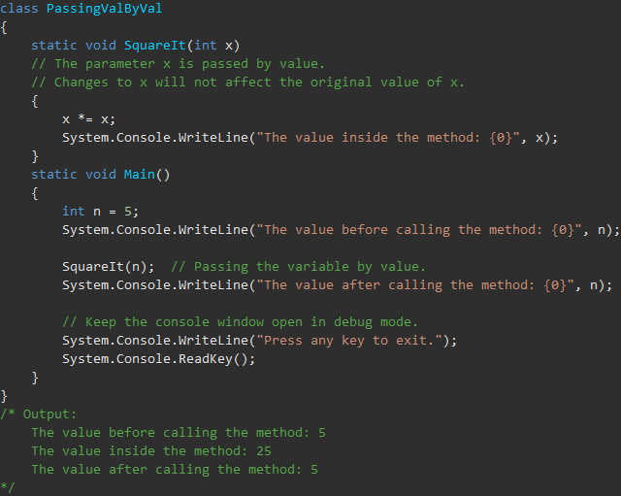
Defining Methods – Pass by Value

Slide 22
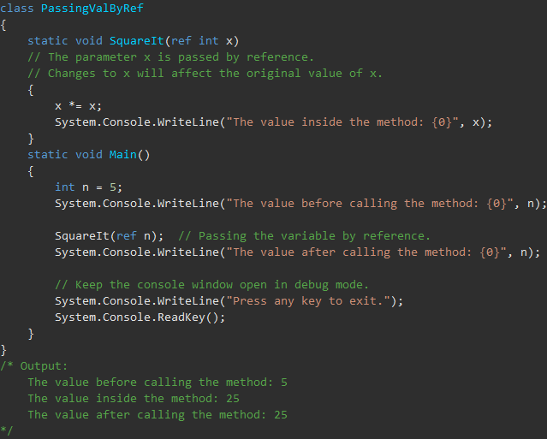
Defining Methods – Pass by Reference

Slide 23
Understanding Constructors
Whenever an object of class or struct is created, its constructor is called.
A class or struct may have multiple constructors that take different arguments.
Constructors enable the programmer to set default values, limit instantiation, and write code that is flexible and easy to read.
If you don't provide a constructor for your class, C# creates one by default that instantiates the object and sets member variables to the default values.

Slide 24
Understanding Constructors
A constructor is a method whose name is the same as the name of its type.
Its method signature includes only the method name and its parameter list; it does not include a return type.
The following example shows the constructor for a class named Person:

Slide 25
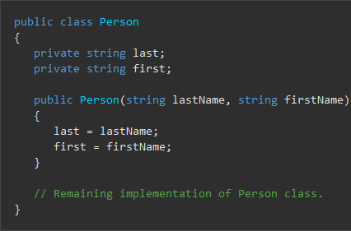
Understanding Constructors

Slide 26
Understanding Constructors
If a constructor can be implemented as a single statement, you can use an expression body definition.
The following example defines a Location class whose constructor has a single string parameter named name.
The expression body definition assigns the argument to the locationName field.

Slide 27
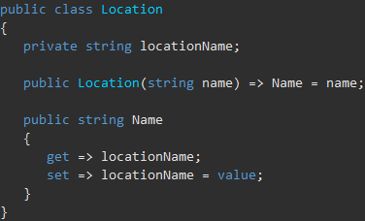
Understanding Constructors

Slide 28
Understanding Constructors
A class or struct can also have a static constructor, which initializes static members of the type.
Static constructors are parameterless.
If you don't provide a static constructor to initialize static fields, the C# compiler initializes static fields to their default value

Slide 29
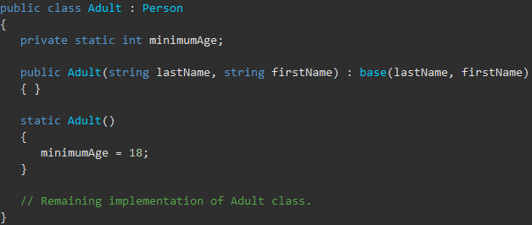
Understanding Constructors

Slide 30
Extending .NET Classes via Inheritance
Inheritance, together with encapsulation and polymorphism, is one of the three primary characteristics of object-oriented programming.
Inheritance enables you to create new classes that reuse, extend, and modify the behavior defined in other classes.
The class whose members are inherited is called the base class, and the class that inherits those members is called the derived class.
A derived class can have only one direct base class.
However, inheritance is transitive.
If ClassC is derived from ClassB, and ClassB is derived from ClassA, ClassC inherits the members declared in ClassB and ClassA.

Slide 31
Extending .NET Classes via Inheritance
Structs do not support inheritance, but they can implement interfaces. For more information.
Conceptually, a derived class is a specialization of the base class.
For example, if you have a base class Animal, you might have one derived class that is named Mammal and another derived class that is named Reptile.
A Mammal is an Animal, and a Reptile is an Animal, but each derived class represents different specializations of the base class.

Slide 32
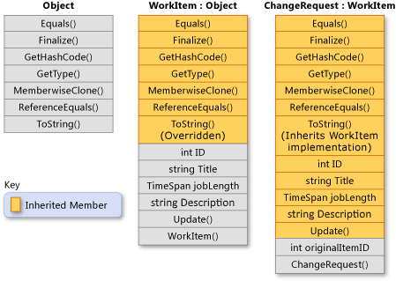
Extending .NET Classes via Inheritance

Slide 33
Defining and Implementing Interfaces
An interface contains definitions for a group of related functionalities that a non-abstract class or a struct must implement.
An interface may define static methods, which must have an implementation.
An interface may define a default implementation for members.
An interface may not declare instance data such as fields, auto-implemented properties, or property-like events.
By using interfaces, you can, for example, include behavior from multiple sources in a class.
That capability is important in C# because the language doesn't support multiple inheritance of classes.
In addition, you must use an interface if you want to simulate inheritance for structs, because they can't actually inherit from another struct or class.

Slide 34

Defining and Implementing Interfaces
The name of an interface must be a valid C# identifier name.
By convention, interface names begin with a capital I.

Slide 35
Defining and Implementing Interfaces
Any class or struct that implements the IEquatable<T> interface must contain a definition for an Equals method that matches the signature that the interface specifies.
As a result, you can count on a class that implements IEquatable<T> to contain an Equals method with which an instance of the class can determine whether it's equal to another instance of the same class.

Slide 36
Defining and Implementing Interfaces
The definition of IEquatable<T> doesn't provide an implementation for Equals.
A class or struct can implement multiple interfaces, but a class can only inherit from a single class.
To implement an interface member, the corresponding member of the implementing class must be public, non-static, and have the same name and signature as the interface member.
When a class or struct implements an interface, the class or struct must provide an implementation for all of the members that the interface declares but doesn't provide a default implementation for.
However, if a base class implements an interface, any class that's derived from the base class inherits that implementation.

Slide 37
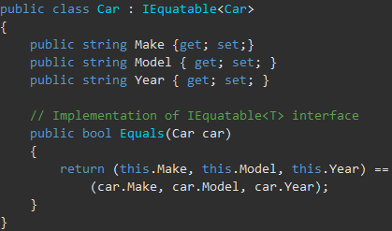
Defining and Implementing Interfaces
The following example shows an implementation of the IEquatable<T> interface. The implementing class, Car, must provide an implementation of the Equals method.

Slide 38
Defining and Implementing Interfaces
An interface is typically like an abstract base class with only abstract members.
Any class or struct that implements the interface must implement all its members.
Optionally, an interface may define default implementations for some or all of its members.
An interface can't be instantiated directly.
Its members are implemented by any class or struct that implements the interface.
A class or struct can implement multiple interfaces.
A class can inherit a base class and also implement one or more interfaces.

